Slide 1
專題報告
12/10
解正平 吳倉永

Slide 2
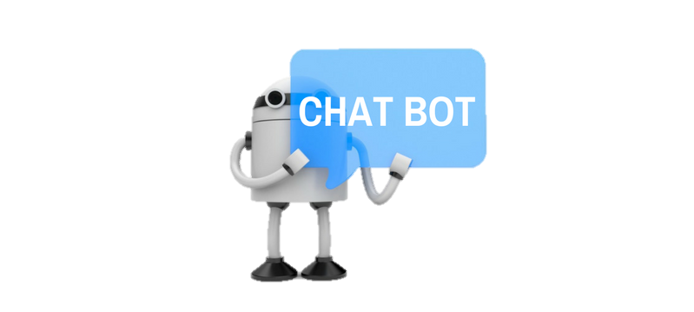

Outline
Database collection
Traditional performance
Siamese Network performance
BERT Network performance
Input Testing

Slide 3
Database collection
Neutral dominated
Too many class

Slide 4
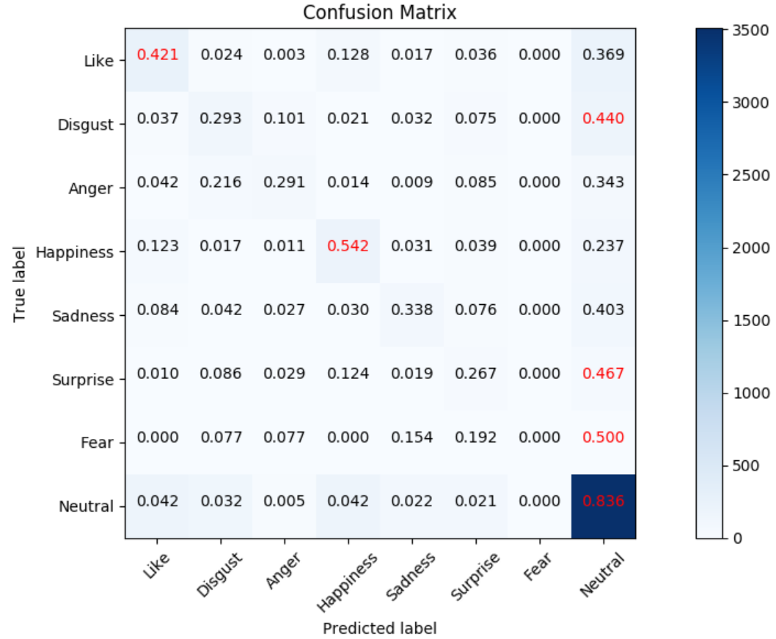
Traditional Performance
Data distribution
We have to solve this problem
Bi-LSTM | REN | NLPCC | NLPCC_ori
fixed-embed | 46.62% | 55.57%
train-embed | 46.85% | 55.35% | 69.25%
rand-embed | 35.88% | 46.42%

Slide 5
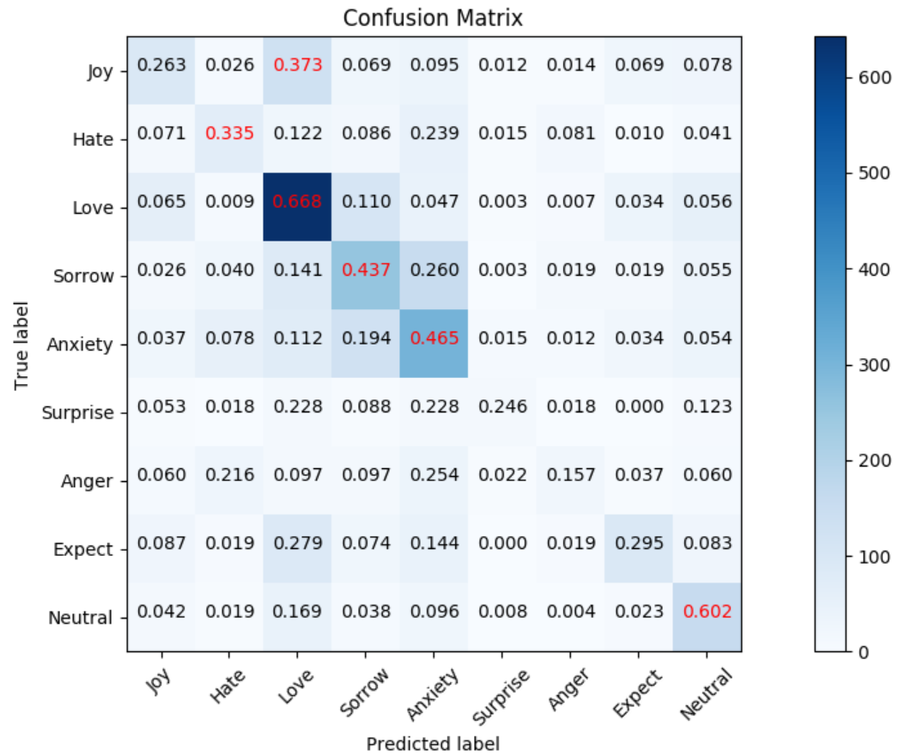
REN Performance (46.85%)

Slide 6
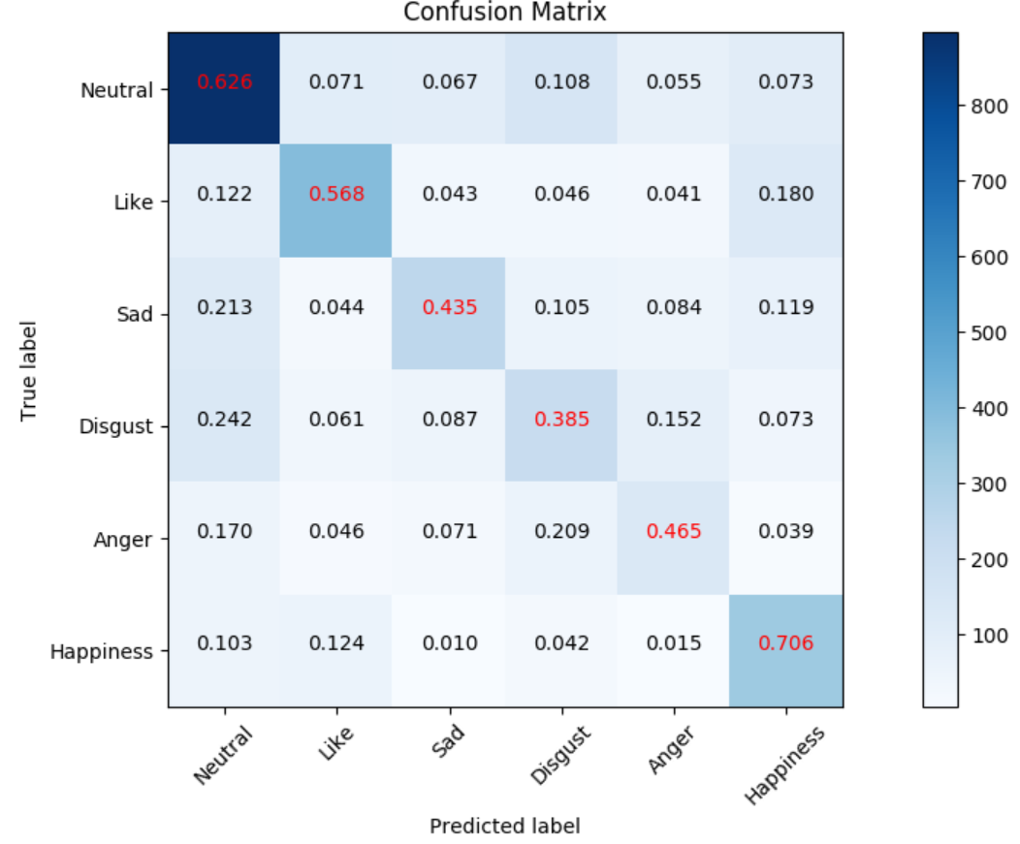
NLPCC Performance (55.57%)

Slide 7
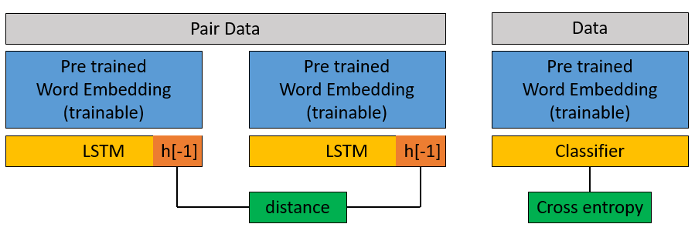
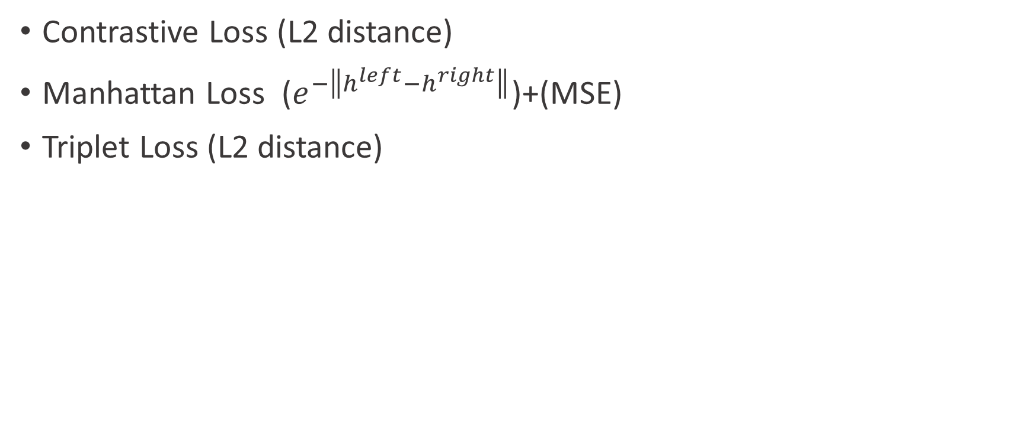
Siamese Performance
Contrastive Loss (L2 distance)
Manhattan Loss ($e^{−\left\|h^{left}−h^{right}\right\|}$)+(MSE)
Triplet Loss (L2 distance)
siamese+classifier | NLPCC
fix-contrastive | 54.00%
train-contrastive | 50.58%
fix-manhatt | 52.33%
train-manhatt | 49.66%
fix-triplet | 54.50%
train-triplet | 51.56%
NLPCC
Triplet Loss | s+c | 0.6819
 | s | 0.743
Contrastive Loss | s+c | 0.1146
 | s | 0.2094
Manhatt Loss | s+c | 0.2252
 | s | 0.4305
NLPCC
Classifier | 55.35%
S+C | 51.56%
Siamese | 42.99%
S->C | 46.15%

Slide 8
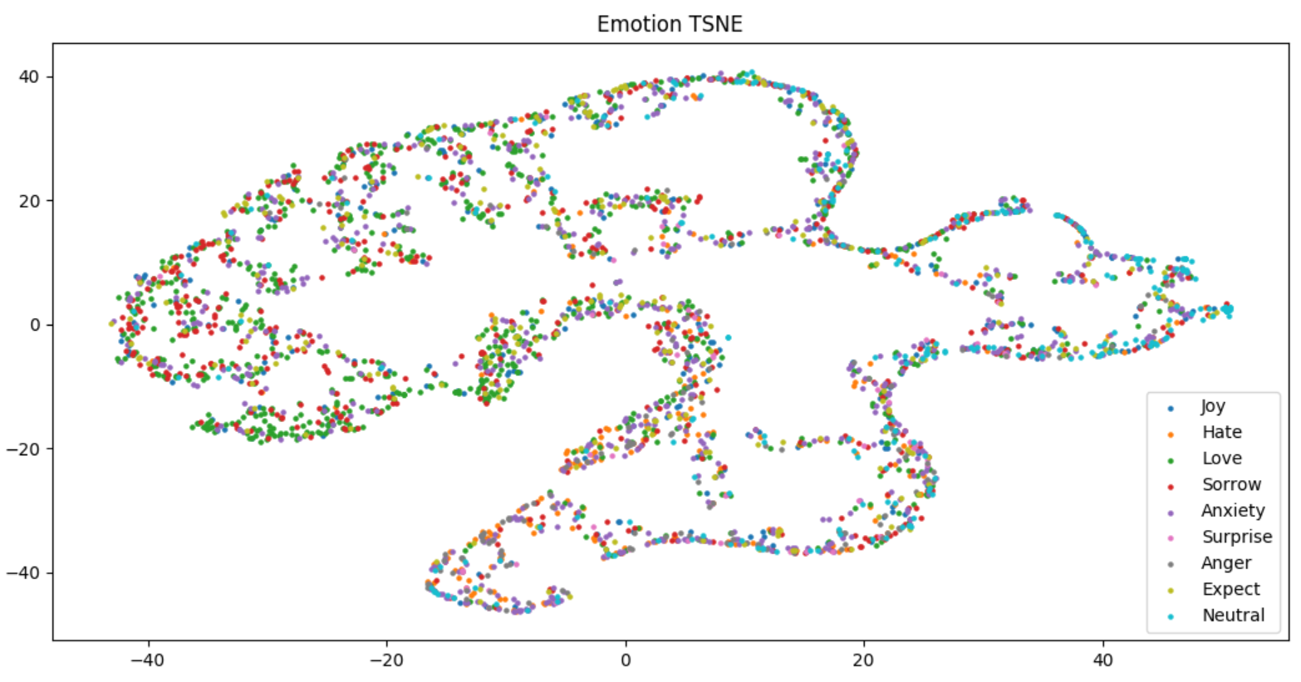
REN Siamese

Slide 9
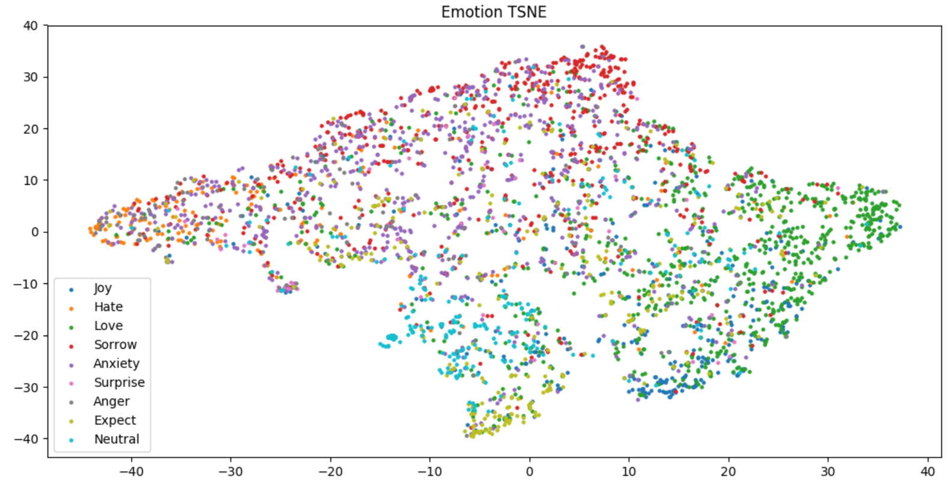
REN Siamese+Classifier

Slide 10
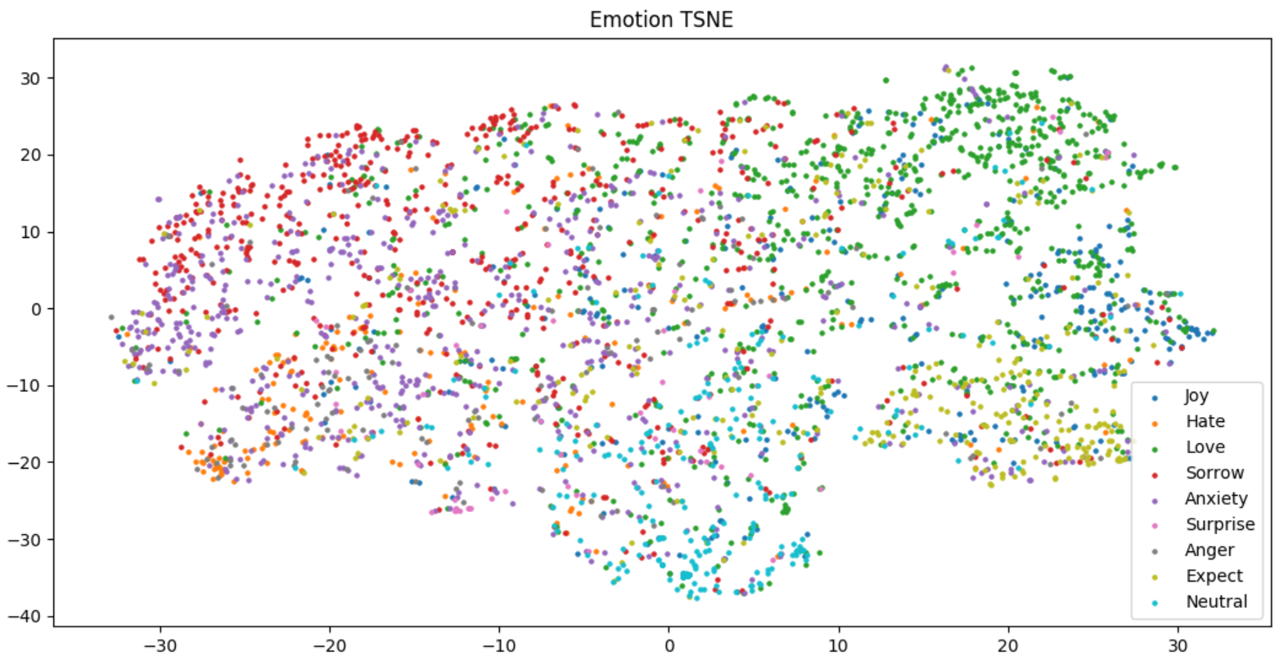
REN Classifier

Slide 11
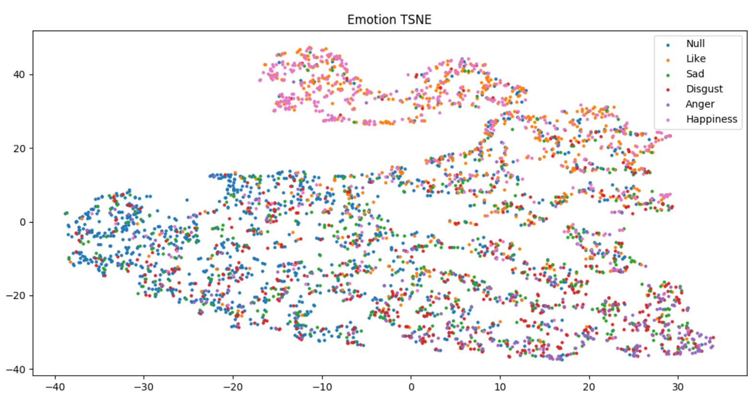
NLPCC Siamese

Slide 12
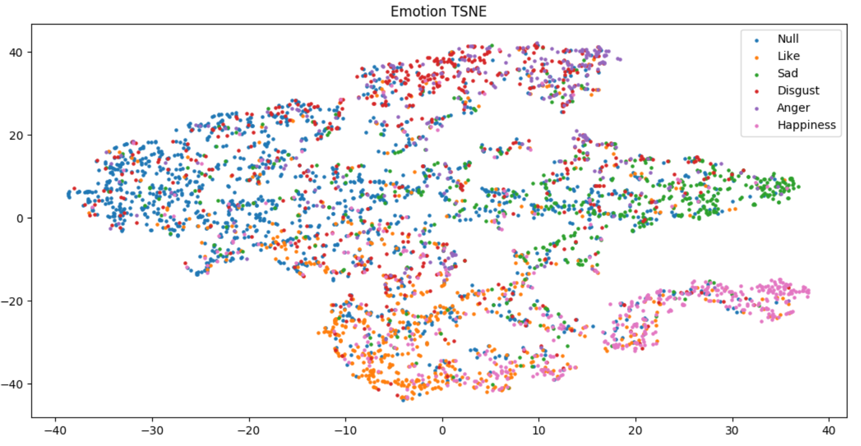
NLPCC Siamese+Classifier

Slide 13
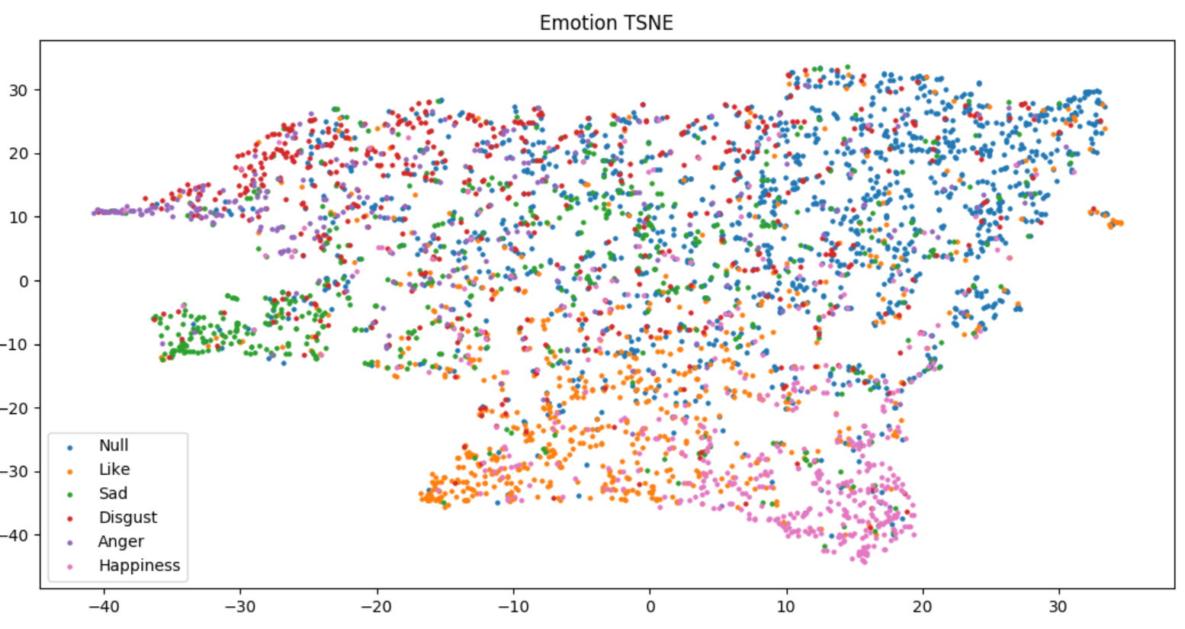
NLPCC Classifier

Slide 14
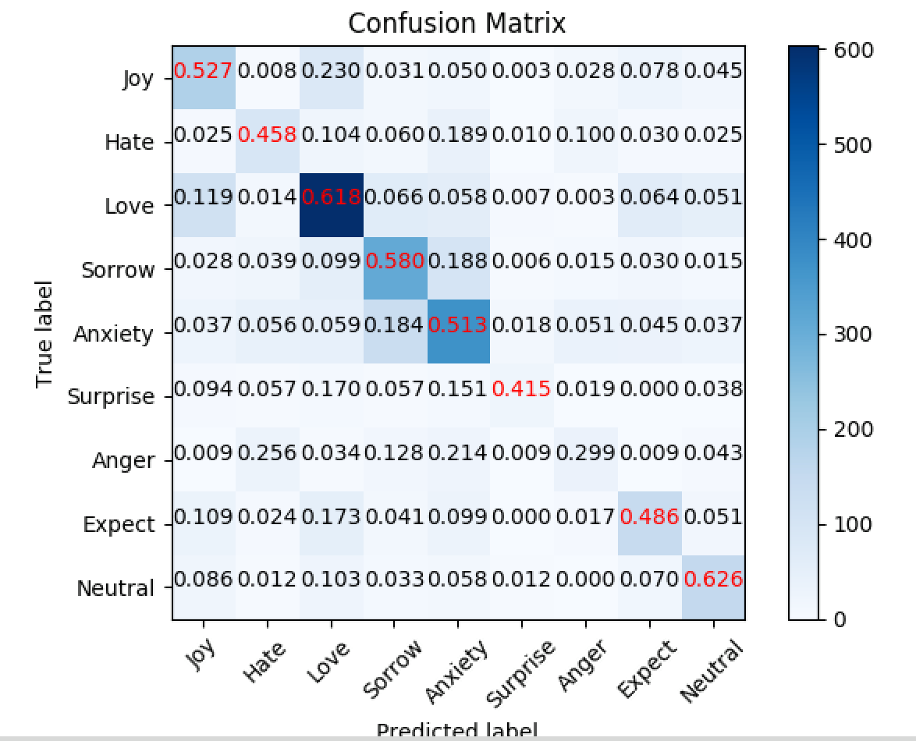
Bert Performance (REN 9) (46.85% vs. 56.06%)

Slide 15
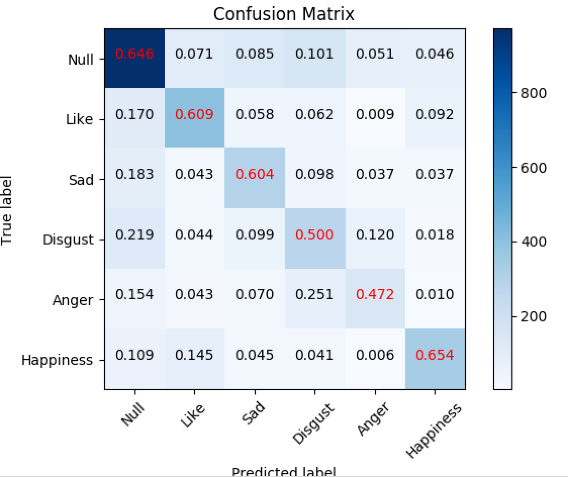
Bert Performance (NLPCC) (55.35% vs. 62.50%)

Slide 16
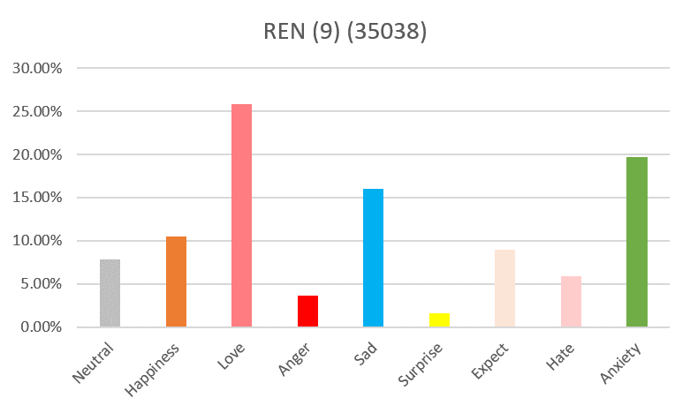
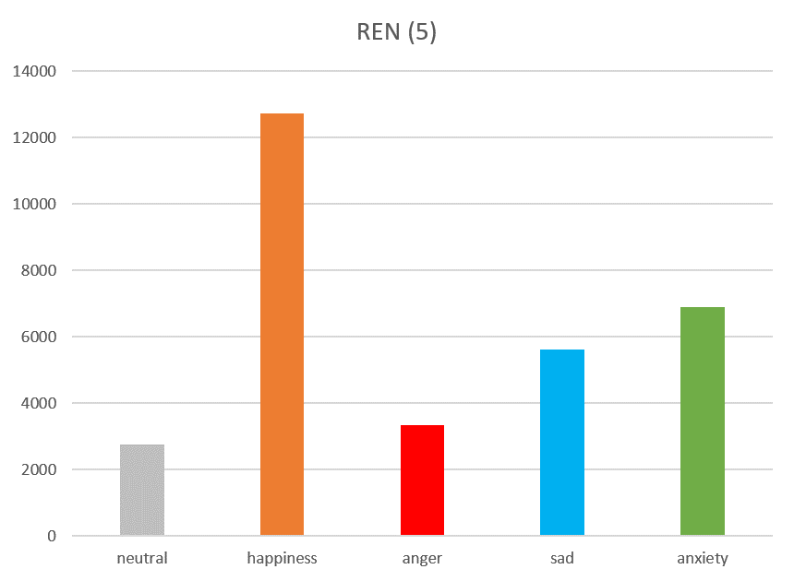
Modify Class Number
Happiness += Love
Anger += Hate
Sad += Anxiety

Slide 17
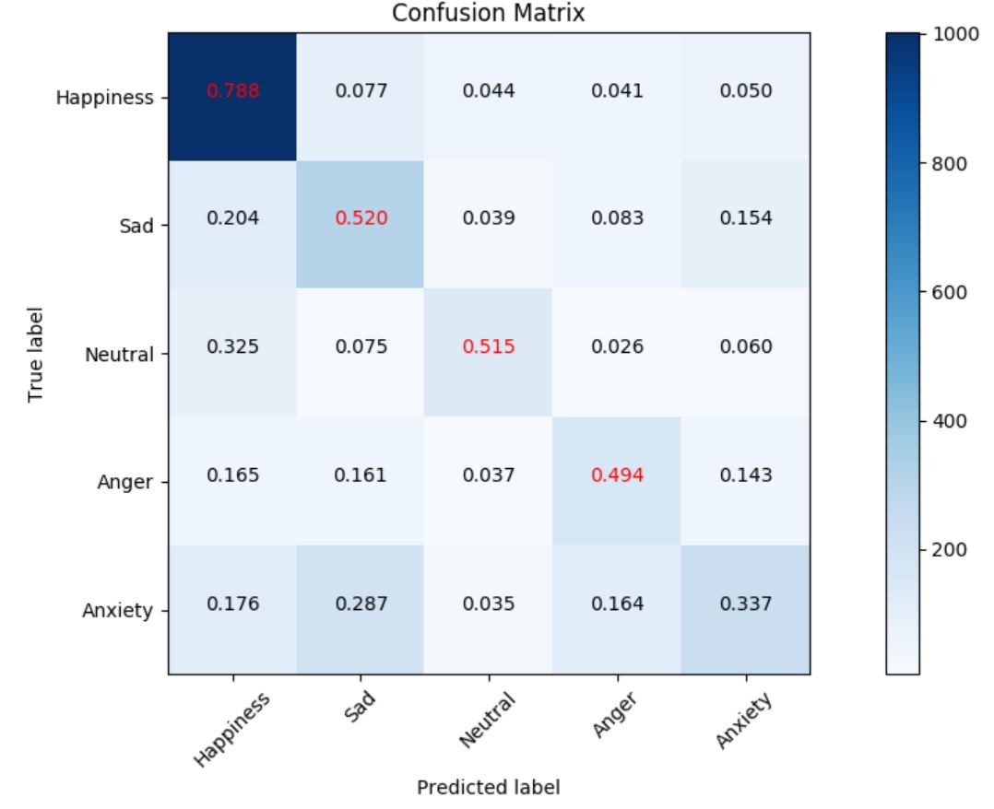
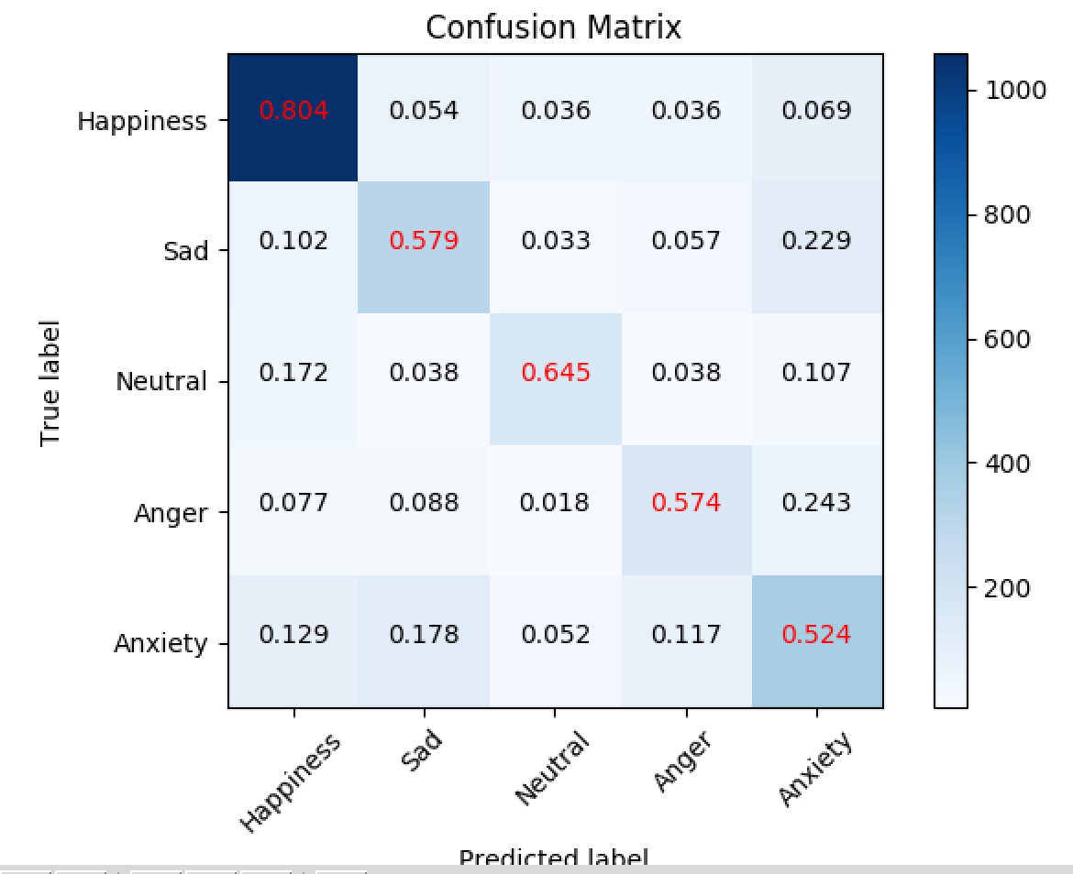
REN 5 label (60.44% vs. 67.5%)

Slide 18
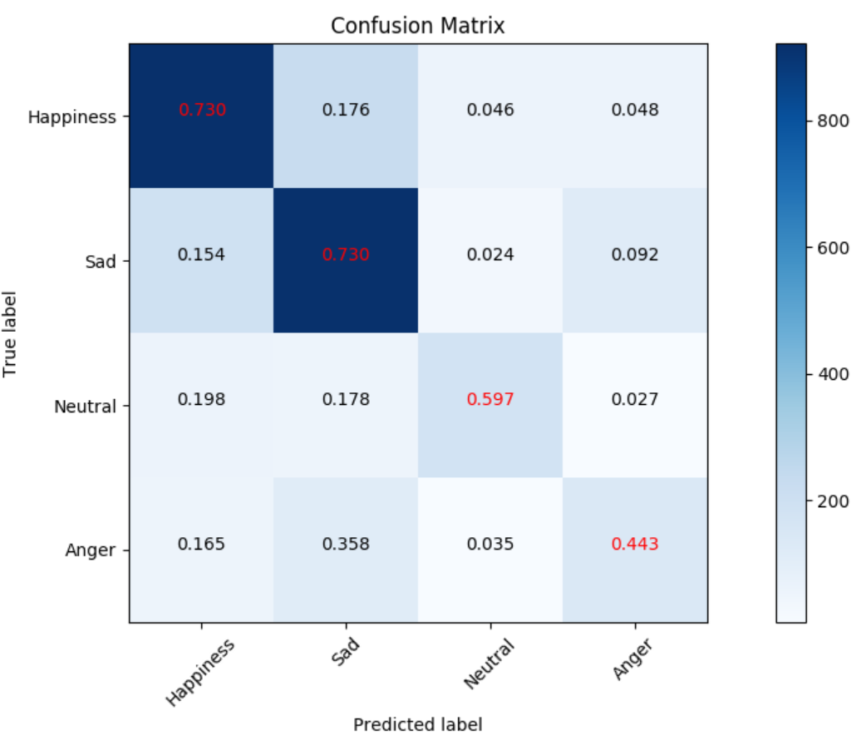
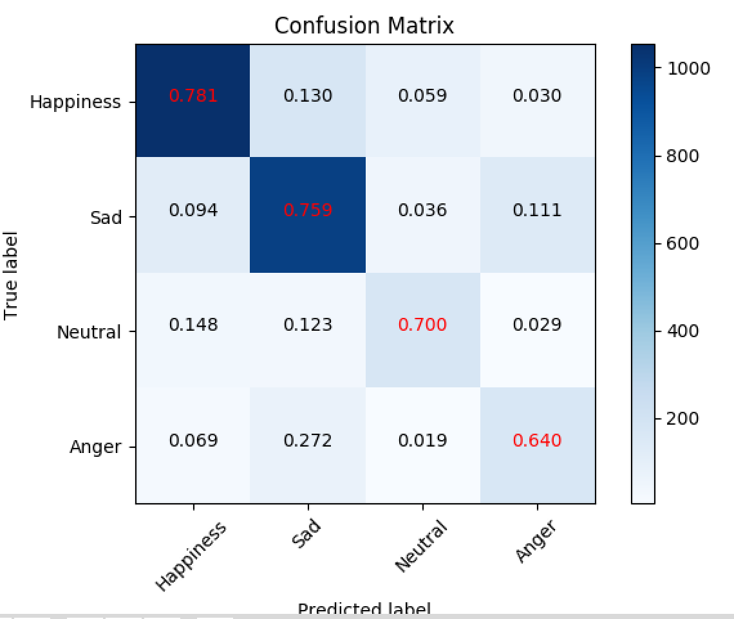
REN 4 label (68.84% vs. 77.31%)

Slide 19
Input Testing
 | BiRNN |  |  | BERT
Input | Ren 4 | Ren 9 | NLPCC | Ren 4 | Ren 9 | NLPCC
我喜歡妳 | Happiness | Love | Like | Happiness | Love | Like
我不喜歡你 | Sad | Sorrow | Like | Anger | Sorrow | Disgust
我愛你 | Neutral | Neutral | Neutral | Happiness | Love | Like
我不愛妳 | Sad | Sorrow | Neutral | Sad | Sorrow | Sad
我恨你 | Sad | Hate | Anger | Anger | Hate | Anger
今天天氣適合出去玩 | Happiness | Joy | Happiness | Happiness | Joy | Neutral
嚇到了吧 | Sad | Anxiety | Neutral | Sad | Anxiety | Neutral
我要得到第一名 | Neutral | Neutral | Neutral | Happiness | Expect | Neutral
希望我能得到第一名 | Happiness | Expect | Like | Happiness | Expect | Like
我家的寵物死了 | Sad | Neutral | Neutral | Sad | Sorrow | Sad
搞砸了 | Sad | Anxiety | Neutral | Sad | Anxiety | Neutral

Slide 20
 | BiRNN |  |  | BERT
Input | Ren 4 | Ren 9 | NLPCC | Ren 4 | Ren 9 | NLPCC
對不起 | Sad | Anxiety | Sad | Sad | Sorrow | Sad
謝謝 | Neutral | Joy | Happiness | Happiness | Joy | Neutral
我現在不想要別人打擾我 | Sad | Anxiety | Neutral | Sad | Anxiety | Neutral
哭笑不得 | Sad | Anxiety | Sad | Sad | Anxiety | Sad
眼淚不停地打轉 | Sad | Sorrow | Sad | Sad | Sorrow | Sad
你不要逼我哦 | Anger | Expect | Anger | Anger | Expect | Neutral
我想殺了妳 | Sad | Expect | Anger | Sad | Sorrow | Anger
你在這樣我就不理你了 | Sad | Anger | Disgust | Sad | Anger | Sad
你看起來很不錯，可是其實你很爛 | Happiness | Love | Like | Anger | Hate | Disgust
人生短短幾個秋 | Neutral | Neutral | Neutral | Neutral | Sorrow | Sad
不醉不罷休 | Sad | Anxiety | Disgust | Happiness | Love | Neutral

Slide 21
Some Experiment for BERT
 | BiRNN |  |  | BERT
Input | Ren 4 | Ren 9 | NLPCC | Ren 4 | Ren 9 | NLPCC
但 | Neutral | Neutral | Neutral | Neutral | Anxiety | Neutral
今天天氣不錯 | Happiness | Joy | Like | Happiness | Joy | Like
今天天氣不錯，但是心情很糟 | Happiness | Joy | Like | Anger | Anxiety | Sad
今天天氣真好，把壞心情趕走 | Happiness | Joy | Happiness | Happiness | Joy | Happiness
今天天氣真糟，但我心情好好 | Happiness | Joy | Happiness | Happiness | Joy | Happiness
今天天氣真好，但心情很好 | Happiness | Joy | Happiness | Happiness | Joy | Happiness

Slide 22
Discussion
How to define the amount of label class
Multi-Label：Human Emotion is a distribution not a value
Training Multi-Label Problem
Not depend on the sentence but word (Word -> Emotion -> Sentence)
Learn distribution
Evaluation Multi-Label Problem (Need reasonable performance)
Give threshold and set multi-label and s@2 performance
Give all label probability not just the max label

Slide 23
Future Work
Train：Multi-label Loss model
Evaluation：Use other method for annotation
Build our own transformer (x)

